Slide 1
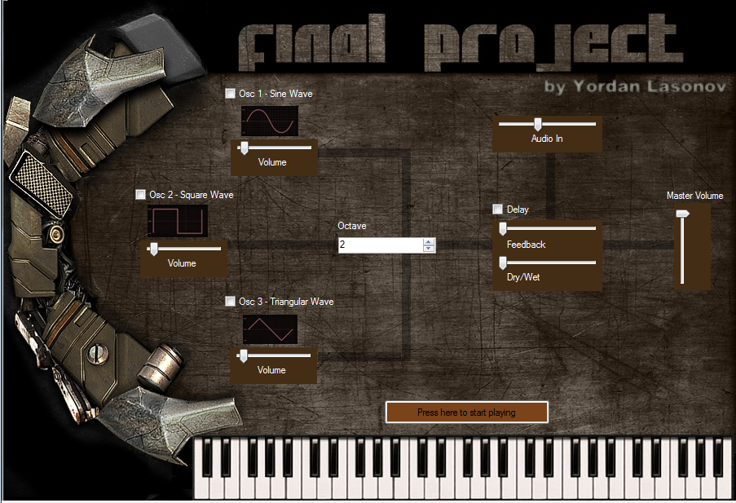
Additive Synthesizer with GUI
By Yordan Lasonov

Slide 2
Overview
In this project, the board was used for creating an additive synthesizer. The synthesizer parameters were mapped to GUI (graphic user interface) created in Visual Basic. In order to facilitate user input music keys, the keyboard was used via serial port.

Slide 3
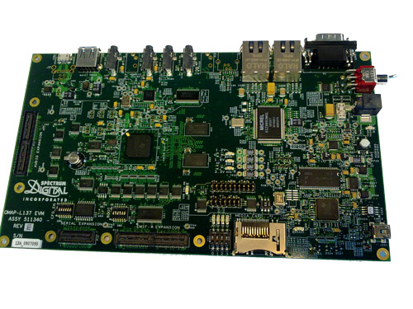
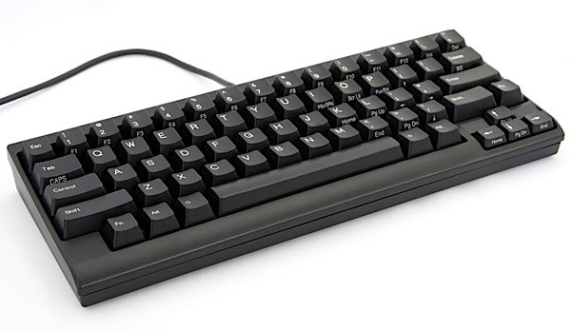
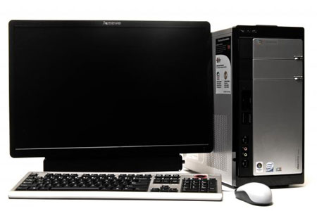
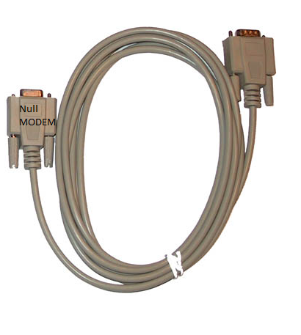
Hardware Components
OMAP-L137
Keyboard
Data Cable
PC
Notes:
Null modem data cable

Slide 4
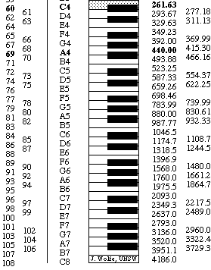
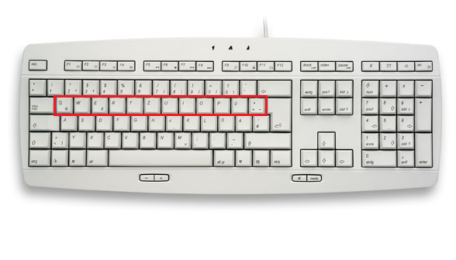
Keyboard
The keyboard input is implemented via serial port from the computer in which Code Composer Studio is running to the board. A Visual Basic application is used in order to read keystrokes from the keyboard and send them via the serial port to the board. In order to read these keystrokes, UART (Universal Asynchronous Receiver/Transmitter) is used.

Slide 5
Software Components
3 Oscillators
Octave control
Audio in channel
Delay effect
Amplifier

Slide 6
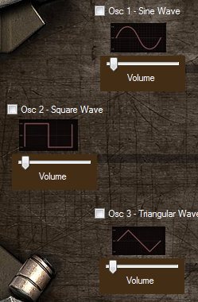
Oscillators
Description:
A sound synthesizer (often abbreviated as "synthesizer" or "synth") is an electronic instrument capable of producing a wide range of sounds. In my implementation, I created a piano which can reproduce 9 different notes. The user, using the graphic interface, can choose and use up to 3 different wave forms.
Sine
Square
Triangular
A volume control for every waveform was added to.

Slide 7


Octave control and audio in channel
Octave control - Description:
In music, an octave is the interval between one musical pitch and another with half or double its frequency. In my implementation, I create an octave control, which allows the user to change between different octaves starting from middle C (C4).
Audio In - Description:
For my audio in channel I used a pass-through function which allows the user to play input audio while using the synthesizer.

Slide 8
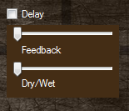
Delay effect
Description
Delay effects store the input signal—and hold it for a short time—before sending it to the effect input or output to create the sound of a repeating, decaying echo. In my implementation I have added delay effect which can be applied on the reproduced audio from the synthesizer or the incoming audio from the audio in channel. I also added a dry/wet slider, which allows the user to control the percentage of the applied delay, and feedback slider, which allows the user to control the delay feedback length.

Slide 9

Amplifier
Description
For every output component, there is a gain which can be used to emphasize or depreciate a certain sample using sliders next to them. But a master volume slider was added also for preventing any kind of clipping in the output audio. In our case the amplifier was modeled with the following linear equation:
Fp[out] = g * Op[out]
Fp[out] – Final Signal
Op[out] – Output signal
g - Gain

Slide 10
Questions?

